Slide 1


Monolithic to Microservices Migration Plan Generator
An intelligent, automated solution that analyzes monolithic code, suggests service boundaries, and generates a clean microservice structure with minimal manual effort.
Notes:
1

Slide 2

Meet The Team
Shubham Tulsyan
Ashish Chauhan
Divyanshu Pathak
Aman Singh
Nitish Pareek
Product Coach: Subhodeep Sarkar
Tech Coach: Subham Chowdhury
Notes:
2

Slide 3


The Challenge: Monolithic Codebase Migration
Manually migrating monolithic codebases to microservices is slow and error-prone. It requires deep technical expertise and an intelligent, automated solution.
Slow Process
Error-Prone
Manual analysis takes significant time.
Risk of mistakes in code understanding.
Expertise Needed
Requires specialized technical skills.
Notes:
3

Slide 4




Our Solution: LLM-Powered Migration Plan Generator
This project transforms monolithic code into a microservices architecture. The process leverages LLMs for intelligent code understanding and service decomposition.
Intelligent Analysis
LLMs deeply understand the code.
Automated Decomposition
Suggests optimal service boundaries.
Documentation
Generates structured documentation.
Notes:
4

Slide 5

Key Project Objectives
Our objectives are to analyze, identify, propose, automate, and deliver.
1
Understand the monolithic structure
2
Identify logical service boundaries
3
Propose a microservices structure
4
Automate documentation using LLMs
5
Deliver a structured .MD File and folder layout for developers
Notes:
5

Slide 6
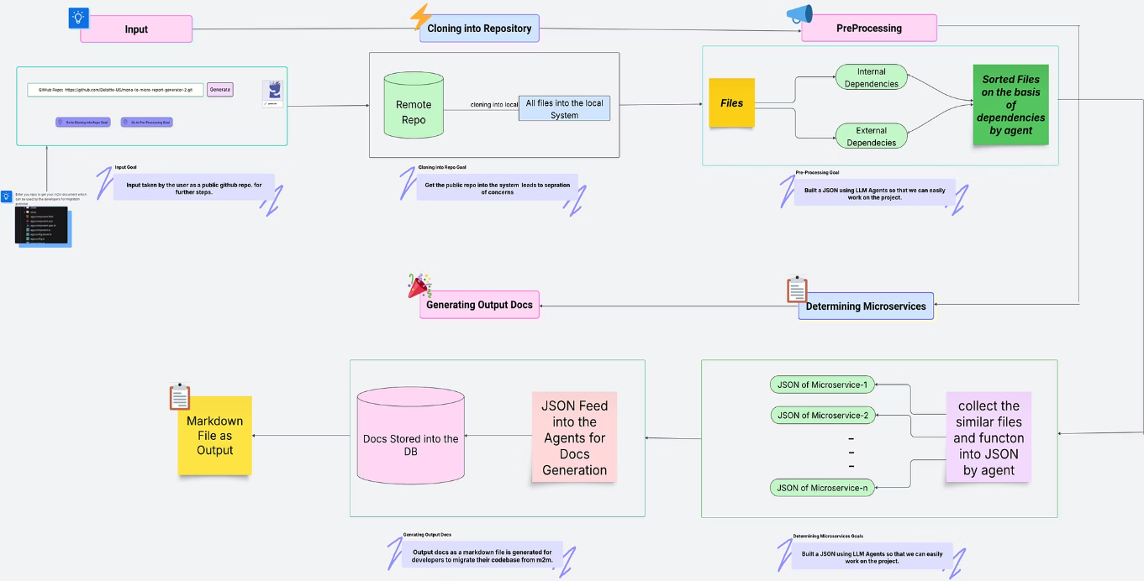
High Level Diagram of the Project
Notes:
6

Slide 7
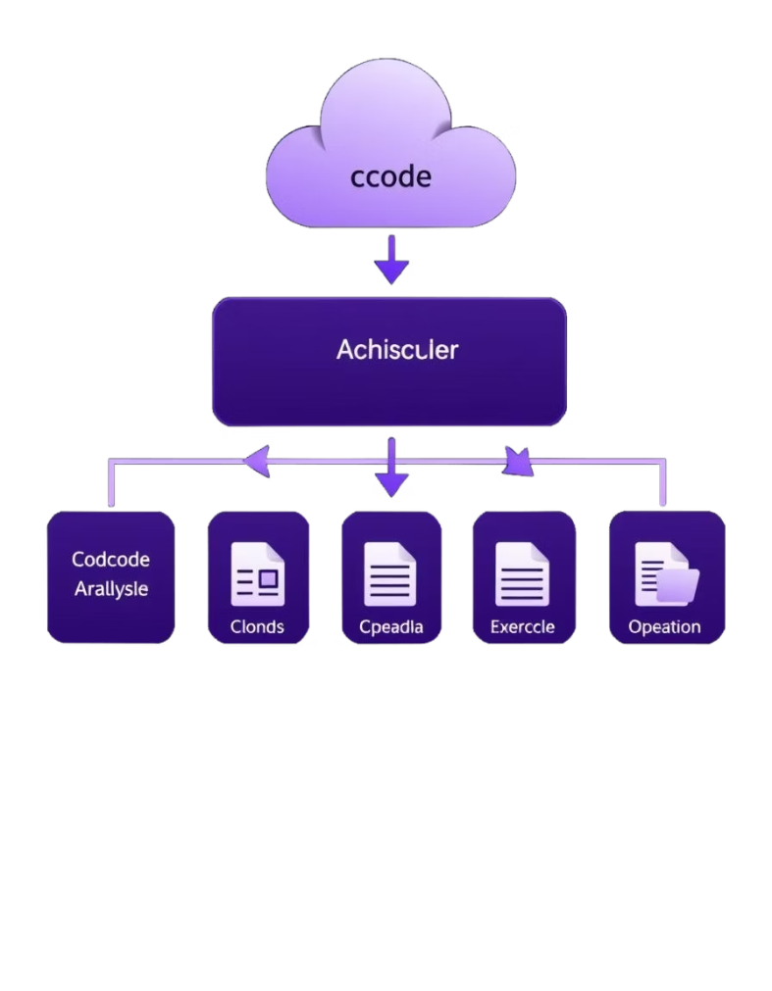




Step 1: Repository Cloning & File Analysis
This initial phase focuses on gathering data from the monolithic repository.
Clone Repo
Clone the monolithic repo to local workspace
Scan Files
Scan files to extract structure and content
Identify Classes
Identify classes, methods, and dependencies
Prepare Data
Prepare data for further analysis steps
Notes:
7

Slide 8
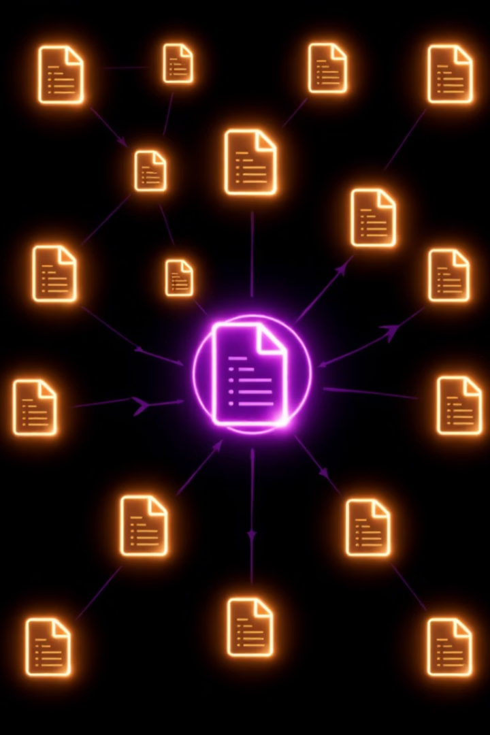




Step 2: File Sorting & Dependency Resolution
This step ensures files are processed in the correct order.
Build Dependency Graph
Handle Circular Dependencies
Sort Files based on dependency resolution order
Ensure correct execution flow for microservice extraction
Notes:
8

Slide 9

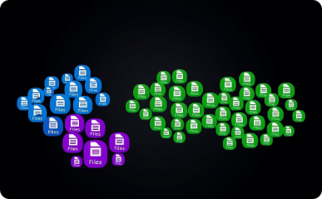
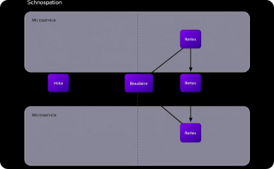
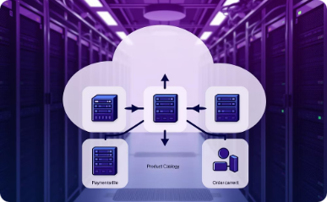
Step 3: Identifying Possible Microservices
Analyze Dependencies
Group Files
Identify Boundaries
Propose initial microservice clusters
Clustering related components
Defining service perimeters
Understanding file relationships
Suggesting service configurations
Notes:
9

Slide 10




Step 4: Generating Code Plan
Mapping files to microservices and structuring output.
Map Files
Extract Details
Detect cross-microservice function calls
Structure output
Notes:
10

Slide 11




Step 5: Consolidated Markdown File - The Migration Guide
1
​Combine all microse​rvice plans into one document
2
Identify classes, methods, and dependencies
3
Highlight cross-service interactions clearly
4
Present as a developer-friendly migration guide
Notes:
11

Slide 12
Thank You!
Notes:
12

